Slide 1


Slide 2
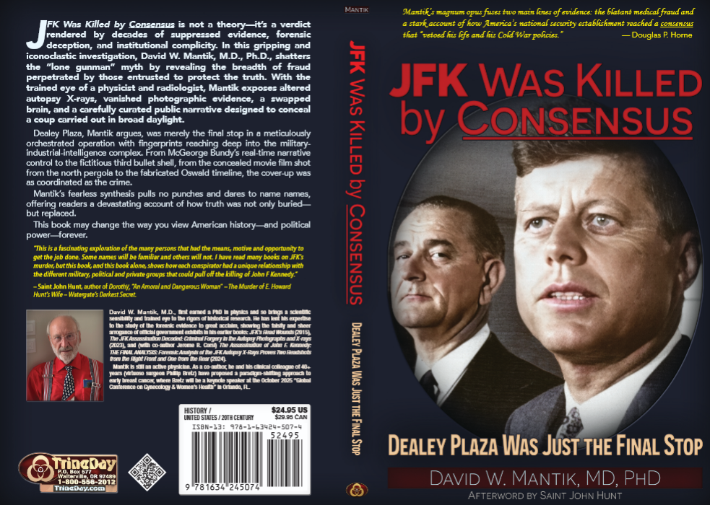

Slide 3
Mantik website:
themantikview

Slide 4
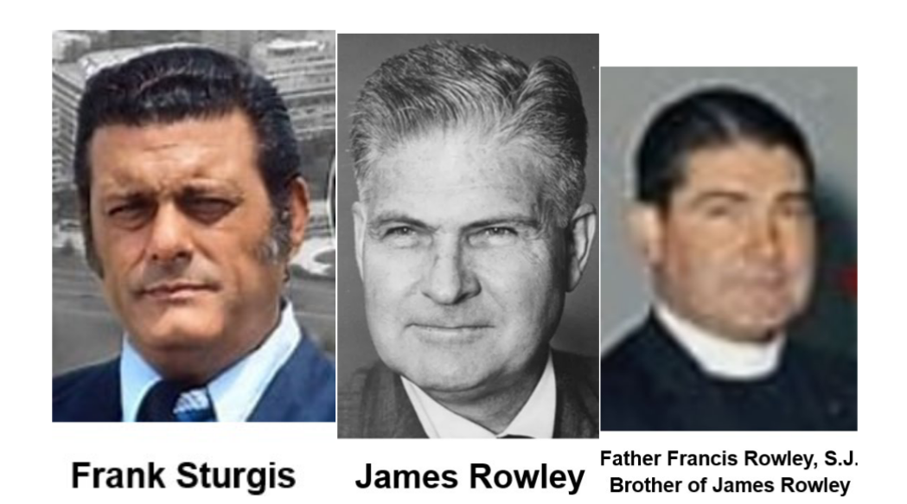
Photo Supplement--online

Slide 5
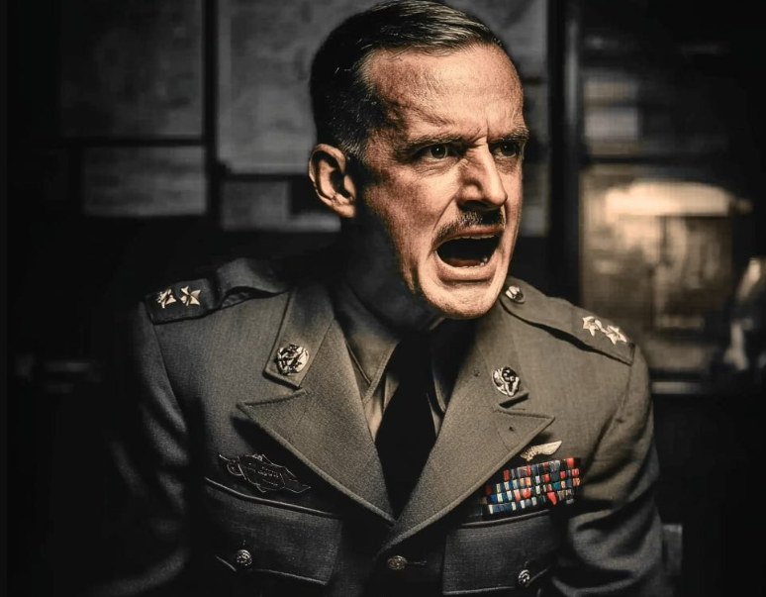
Lansdale Supplement--online

Slide 6
On Monday, November 3, 2025, Bruce B. wrote:
As 11.22.2025 approaches 62+ years after the JFK removal
virtually nothing has been accepted overall, agreed to, believed,
combined into any semblance of an intelligent cogent dialogue
or combined books/book treatises, narratives, outlines, etc.,
with any universal dispositive assessment of salient issues
whatsoever anywhere/anyplace/anytime.

Slide 7
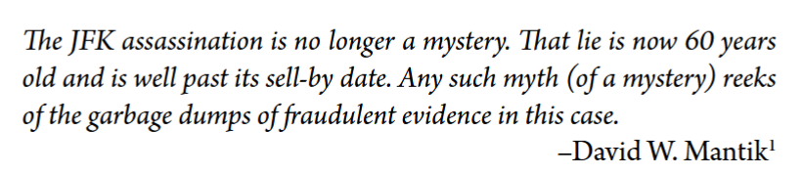
Bruce B. has not been paying attention.

Slide 8
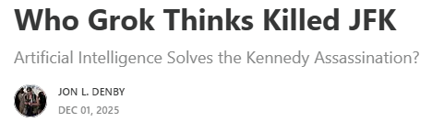
Dec 1, 2025: Artificial Intelligence
Who Grok Thinks Killed JFK - Jon L. Denby

Slide 9
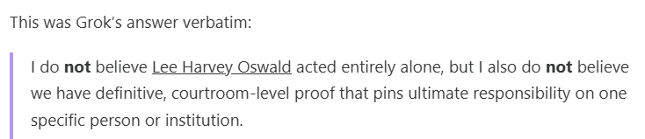
Grok: In a nutshell

Slide 10
Grok: Only 3 groups
1. CIA: Harvey, Morales, Phillips—and maybe Barnes & Lansdale
2. Anti-Castro Cubans
3. Mafia: Marcello or Trafficante
  Talbot (2015) has little* (or no) mention of these characters (but see my book):
Charles Willoughby Paul Helliwell
Wm. C. Bishop Jean Rene Souetre*
Carl Jenkins Otto Skorzeny*
Delk Simpson Lyman Lemnitzer*
Howard Burris Ed Clark*
Gordon McLendon Operation Gladio*
    * Given Grok’s emphasis on Allen Dulles, Grok’s primary source was likely Talbot (2015).
    But The Devil’s Chessboard is now 10 years out of date!

Slide 11
Grok: Allen Dulles and Angleton at the top
Dulles: #1-- but more as a “godfather,” who blessed the plan.
DM: But Allen was getting senile (see my book).
Angleton: #2.
DM: But he was confused about the Mexico City escapade.
Curtis LeMay & Charles Cabell
DM: I agree—Lansdale and Cabell were good friends.

Slide 12

Grok: LBJ?
DM: This is confusing use of English: Is it <10% for each one of these?
DM: It should be <1% for the USSR and for Castro.
DM: LBJ likely did not order it, but he must have blessed it—so, over 95% probability that he knew.

Slide 13
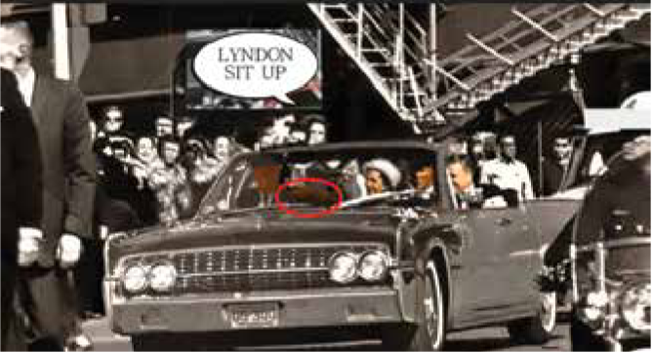
So, why did LBJ duck? Lady Bird did not!

Slide 14
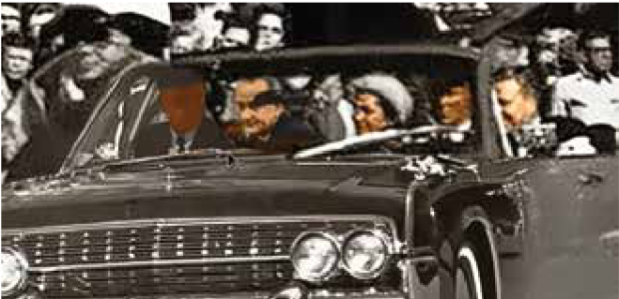
LBJ re-inserted!

Slide 15
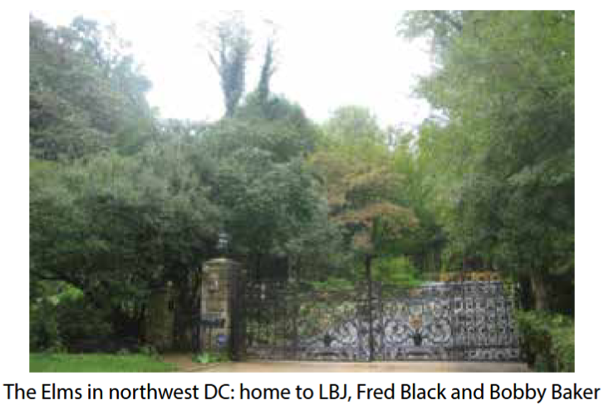
Home, Sweet Home!

Slide 16
Fred Black (not in Talbot’s 2015 book)
LBJ & Fred Black & Bobby Baker owned 3 houses in a row.
Fred Black was a good friend of Johnny Roselli—and warned him in advance about his (Roselli’s) pending murder in 1976.
So, did Roselli tell Black about JFK’s pending murder?
Recall that Roselli and Harvey were close drinking buddies.

Slide 17
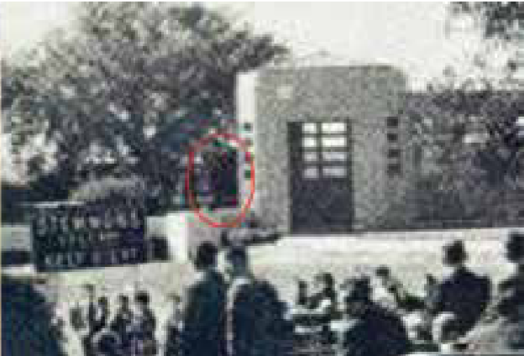
Betzner--one of six films with Black Patches

Slide 18
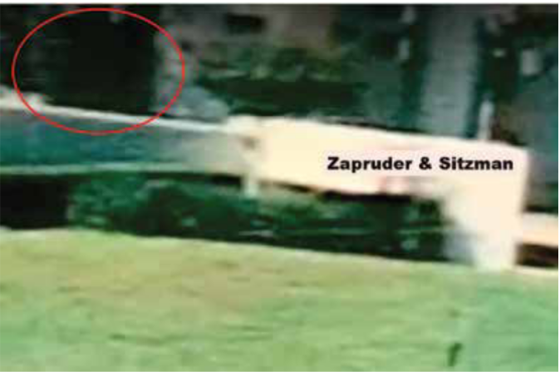
Nix—one of six films with Black Patches

Slide 19
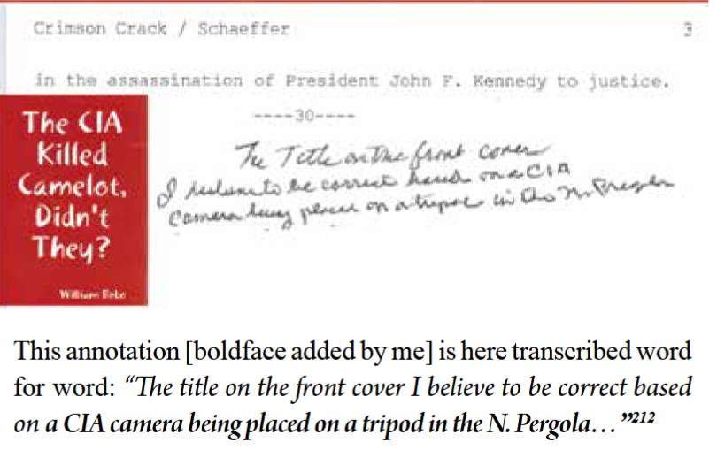
Roy Schaeffer

Slide 20
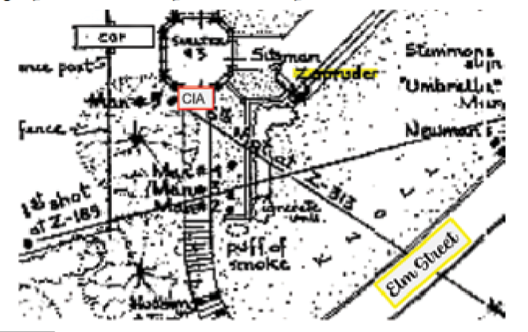
Dealey Plaza

Slide 21
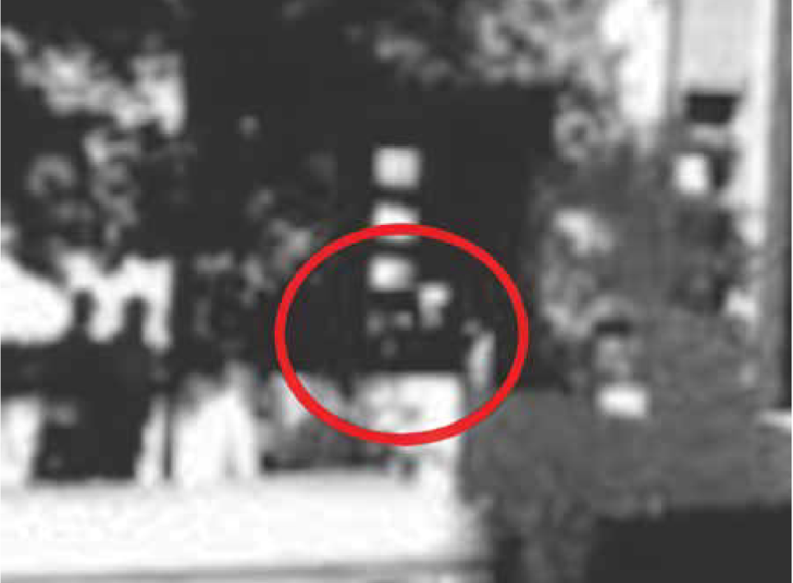
The CIA photographer—in a sailor’s cap?

Slide 22
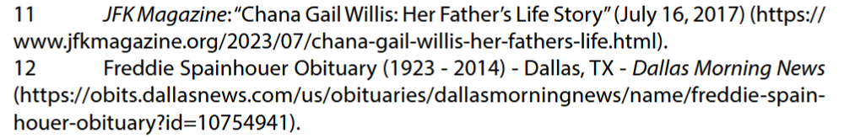
Freddie Spainhouer Obituary

Slide 23
For the Cover-up: Patches everywhere!
--the fake 6.5 mm bullet cross section on the AP skull X-ray
--an artificial White Patch (on both lateral X-rays)
--a bogus Red Spot in the autopsy head photograph)
--a geometric Black Patch in Z-317
--Black Patches in Moorman, Nix, Bell, Rickerby, Betzner, and Bronson.
--Perhaps we should retitle the JFK execution and cover-up as…
“The JFK Assassination Follies.”
If so, the motto of these worker bees should have been “Have Brush, Will Travel.”

Slide 24
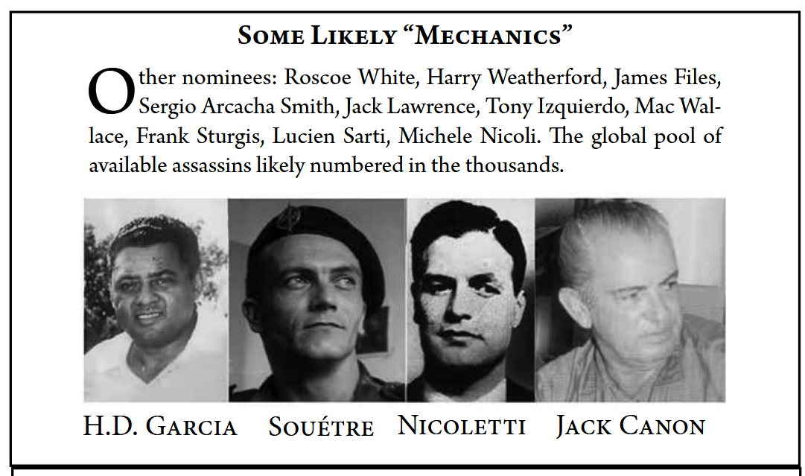
Possible Mechanics

Slide 25
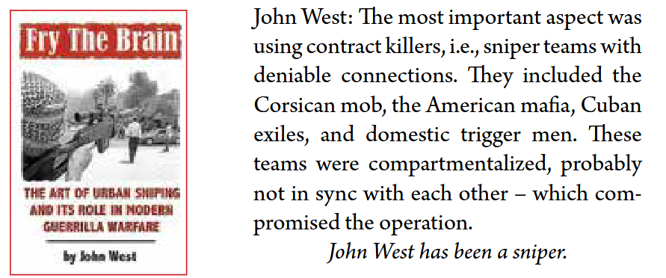
Observations from a sniper

Slide 26
Allen Dulles – per Stephen Kinzer
In 1965, Schlesinger and Sorensen published articles blaming Allen for the Bay of Pigs fiasco.
So, Allen began work on a rebuttal, but it was never published. His sister Eleanor believed that he “…had already begun to lose his command over his memory and ideas.”
She persuaded him not to publish.
In the late 1960s, Allen began losing his way on the Georgetown streets. “Perhaps it was what we call Alzheimer’s disease today,” a relative reported.

Slide 27
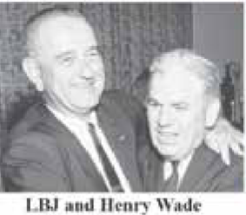
Good buddies

Slide 28
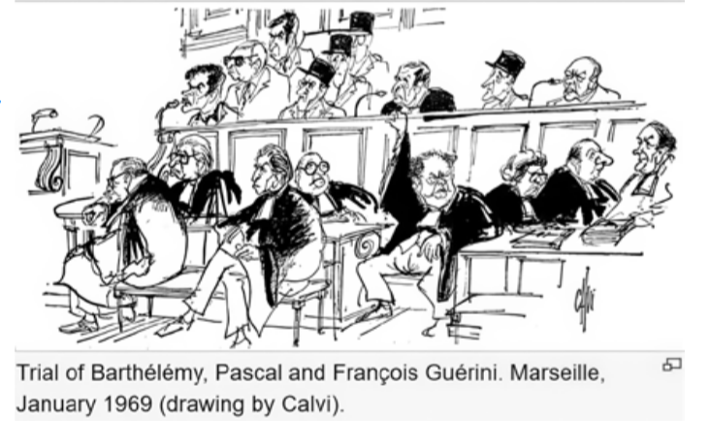
Also missing from Talbot: the French Connection—and anything from Alfred McCoy

Slide 29
Coup d'état
Definition: An illegal attempt – by a small minority - to take over a government.
Recently: 15 events per year

Slide 30
Coup d'état attempts
As common as…
stars in the sky,
or as common as Dodgers in the playoffs.

Slide 31
1950-2010 (a 60-yr interval)
Total = 457 total coups (7.5 per year)
Success rate = 50%

Slide 32
Historical Coups
1653. Oliver Cromwell deposes Charles I
1688. James II deposed – by his own daughter!
1799. Napolean ends the French Revolution
1893. Queen Liliuokalani
WC John McCloy claimed that the US was not a banana republic.
But Hawaii was a fruit juice republic—a coup triggered by US businessmen.
In 1993, the US apologized to native Hawaiians for the role of US agents.

Slide 33
Historical Coups
1917. Bolsheviks subvert the Russian Revolution
1933. American businessmen fail to recruit Gen. Smedley Butler to overthrow FDR.
1940. In Norway, Quisling attempts the world's first radio-broadcast coup d'état.
1943. Mussolini hung out to dry – with his mistress
1944. Valkyrie attempt fails
1945. Hirohito attempt fails
1959. Castro deposes Batista
2016. Russiagate attempt to overthrow Trump

Slide 34
Regime Change by US (Cold War Era)
Italy (1948): The CIA swung the 1948 general election to the centrist Christian Democrats and intervened in Italian politics until the early 1960s.
Syria (1949): The CIA supported a military coup that ousted the country's democratically elected government.
Iran (1953): The CIA orchestrated the overthrow of the democratically elected Prime Minister Mohammad Mossadegh, who had nationalized the oil industry. The coup restored Mohammad Reza Pahlavi, a pro-Western monarch, to the throne – and initiated a fiendish reign by the Savak.

Slide 35
Guatemala (1954): The CIA backed a military coup against the democratically elected President Jacobo Árbenz Guzmán. The intervention was driven by the connections of Allen Dulles and Nelson Rockefeller to the United Fruit Company, which opposed the land reforms of Árbenz.
Congo (1960): The CIA assisted in the assassination of Patrice Lumumba, the country's first democratically elected prime minister. This intervention fueled instability that helped Mobutu Sese Seko to seize power in 1965 – and maintain it for 32 years. This is the legacy of Allen Dulles.
Cuba (1961): The CIA (via Richard Bissell and Mac Bundy) launched the Bay of Pigs invasion, a thoughtless attempt to overthrow Fidel Castro's communist government.

Slide 36
South Vietnam (1963): The U.S. supported the assassination of President Ngo Dinh Diem, which infuriated General Ed Lansdale (a friend of Diem).
Brazil (1964): The CIA backed a military coup that overthrew President João Goulart, thereby installing a military dictatorship that ruled until the 1980s.
Chile (1973): The U.S. provided support to Augusto Pinochet, who staged a coup to oust the democratically elected socialist President Salvador Allende.
Afghanistan (1979–1992): The U.S. provided billions in arms and aid to the mujahideen rebels fighting against the Soviet-installed communist government.

Slide 37
Post-Cold War Era
Panama (1989): The U.S. invaded Panama to oust its de facto leader, Manuel Noriega.
Iraq (1991): The U.S. invaded Kuwait to remove occupying Iraqi forces but refused to aid a subsequent uprising by Kurds and Shias against Saddam Hussein.
Haiti (2004): The U.S., along with France and Canada, backed a coup that removed the democratically elected President Jean-Bertrand Aristides. [pronounced ArisTIdez]
Afghanistan (2001): A U.S. invasion overthrew the ruling Taliban government, replacing it with a U.S.-backed government.
Iraq (2003): A U.S. invasion overthrew Saddam Hussein.
Libya (2011): The U.S. provided military support to rebels during the civil war that overthrew Muammar Gaddafi. Slavery markets followed—thanks to Hillary Clinton, who was ironically awarded the Presidential Medal of Freedom!

Slide 38
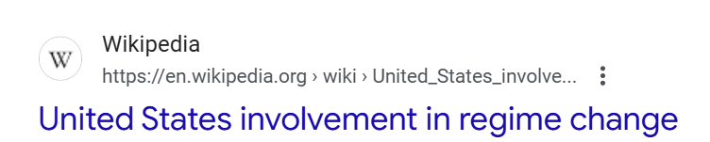


Slide 39
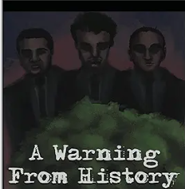
Cory Hughes (2025)

Slide 40
Hughes: Oswald in Mexico
Hughes agrees with Larry Rivera and with David Josephs—
Oswald did NOT go to Mexico.
But someone did–it was William Seymour!

Slide 41

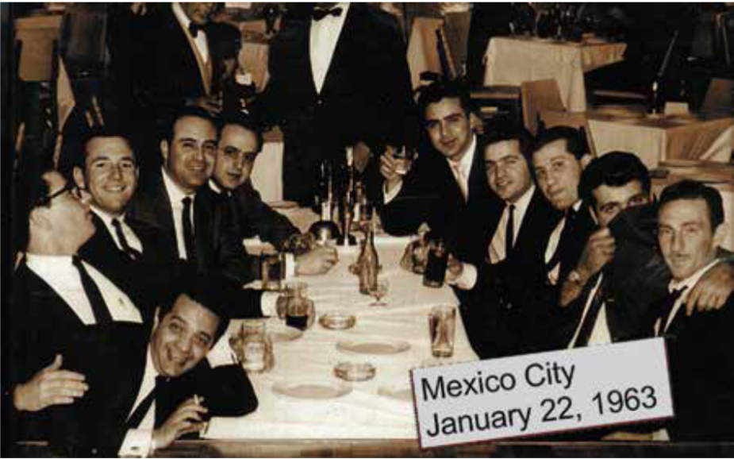
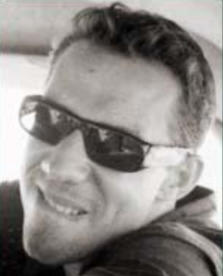
William Seymour

Slide 42
Hughes: Seymour impersonated Oswald frequently, including …
While visiting Silvia Odio
At the gun range
At the gun shop
In Ferrie’s movie of the Pontchartrain training camp
At the Walker shooting
At the car dealership
Escaping the TSBD in a station wagon
After the event, as seen by Robert Vinson in that military plane

Slide 43
Seymour Bio
Spartacus: William Seymour.
Born in Fort Benton, MT. Spent 3.5 years in the Pacific with the navy.
Was a member of Interpen, established in 1961 by Gerry P. Hemming. Others included Loran Hall, Roy Hargraves, Lawrence Howard, and Manuel Aguilar (no kin to Gary)….
They were funded by the CIA.
Seymour may have fired from the west end of the TSBD (6th floor).

Slide 44
Hughes: Kerry Thornley also often impersonated Oswald, including …
At Ferrie’s apartment (as seen in the movie JFK)
While approaching Tippit’s car. David Ferrie was there, too—the shells were from two different guns.
Arranged for the fliers that LHO distributed
Was often seen at 544 Camp St. (this was not LHO)
Was in Clinton, LA with Ferrie and Shaw (not LHO)
Was seen driving a car (not LHO)
Knew Perry Russo
Used the name Leon Oswald
Was also captured in the Texas Theatre…
11. But then was promptly released near a red 1961 Falcon with Carl Mather’s license plate.

Slide 45
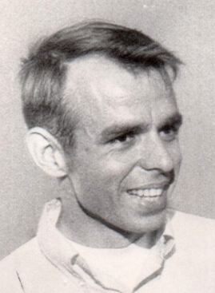
Thornley and LHO
(Hughes: Garrison understood Thornley’s role)
In early 1959, they served together in the same radar unit at El Toro in Santa Ana. They both liked discussing literature (e.g., 1984), politics, and Marxism. Thornley had also lived in New Orleans. They were both atheists—and in 1960, Kerry served at Atsugi, LHO’s former unit (1957-59).
Thirty months before 11/22/1963, Thornley started writing a book (The Idle Warriors) about LHO!
1968

Slide 46
Spartacus: Thornley confesses
He was on TV: A Current Affair. He confessed that he had been part of a conspiracy to assassinate JFK. However, he did not name his fellow conspirators.
He died in 1998. He was then working on a book with the journalist Sondra London; Confession to Conspiracy to Assassinate JFK was published in 2000.

Slide 47
Hughes: Re. Thornley
Kerry was connected to
Johnny Roselli and to Carlos Marcello.

Slide 48
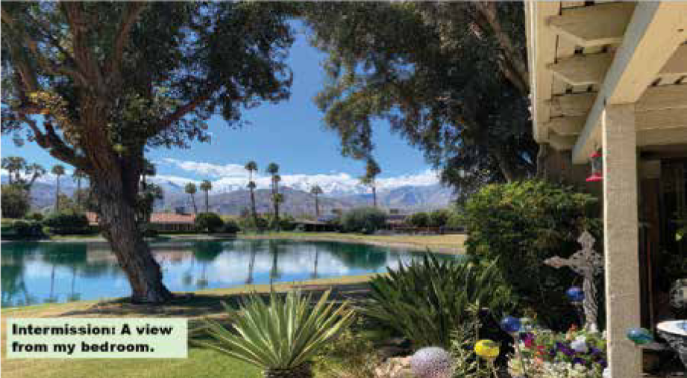
A View from Home

Slide 49
November 4, 2025, was the 30th anniversary of the assassination of Yitzhak Rabin.
--Rabin departed Dallas on 11/22/1963 and only learned of JFK’s death on landing in Israel that same day.
--Many Israelis considered Rabin’s death to be a coup d'état.
--He was replaced by Shimon Peres, who won the 1994 Nobel Peace Prize (and was related to Lauren Bacall). Netanyahu was then the opposition leader to Rabin.
--Peres was the godfather of the Israeli nuclear program.
--He was best friends with Arnon Milchan, who produced the movie, JFK.

Slide 50
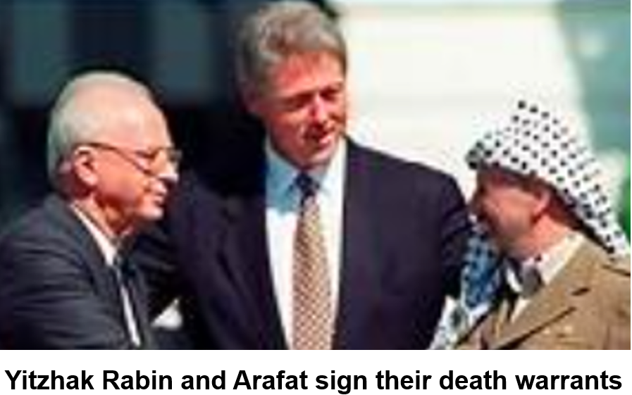

Slide 51
Leah Rabin
--Refused to shake the hand of Netanyahu* when he came to her house to offer condolences, but …
--later, she embraced Arafat.
--The parallels between the JFK and Rabin assassinations are uncanny—while emerging details about Charlie Kirk are beginning to sound like an echo.
*Leah shook his hand at the funeral (because it was public) but later refused to do so when he visited her house.
--Zionism: The Real Enemy of the Jews, Volume III, by Alan Hart, p. 269.

Slide 52
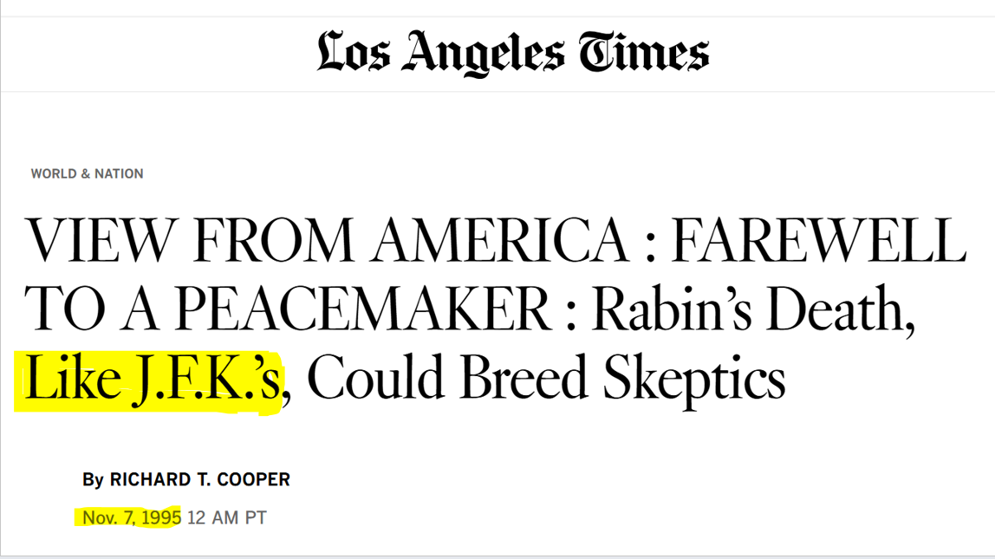

Slide 53
Assassinations: JFK vs. Rabin
--Some of those [1995] posters portrayed Rabin as a traitorous, Hitler-like figure in a Nazi SS uniform.
--The Jerusalem Post (November 3, 2025)
--On 11/22/1963, JFK was portrayed in the Dallas Morning News as a traitor.
--The videotape of Rabin’s shooting was probably altered – an echo of Zapruder film manipulation.

Slide 54
Yiguel Amir (the “lone assassin”) had worked for Shin Bet (Israeli security).
LHO (a “lone assassin”) had worked for ONI.

Slide 55
Assassination of Yitzhak Rabin - Wikipedia
The chief of internal security, Carmi Gillon, alerted Netanyahu of a plot on Rabin's life and asked him to moderate the rhetoric of the protests. Netanyahu declined to do this.

Slide 56
Netanyahu
--is the only foreign leader who has denied killing Charlie Kirk.
--He did NOT attend the recent protest rally for Rabin—although it is traditional for Israeli prime ministers to do so.

Slide 57
“The shots still resonate” -- 150,000 mourn at protest rally 30 years after Rabin’s murder.
--The Times of Israel, November 2, 2025
This rally was held in Rabin Square. It ended with a “Song for Peace,” which Rabin himself sang at his own rally 30 years before. He was promptly shot after that, while Leah was told that the bullets were only blanks.* As in JFK’s autopsy, there was remarkable confusion about Rabin’s wounds.
At this recent rally, attendees held signs calling for peace and reading “Rabin was right” – while Israel’s right wing still disagreed with this sentiment.
*Assassin 'told guards bullets were fakes' | The Independent | The Independent

Slide 58
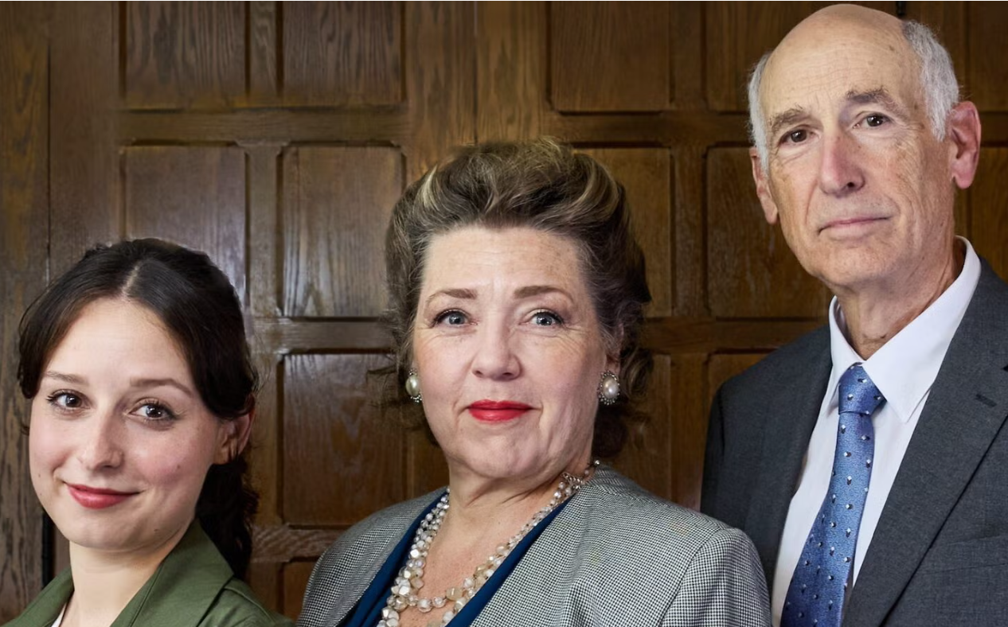
“November 4” is a musical play about Rabin, whose political assassination changed Israeli history (news on November 3, 2025).

Slide 59
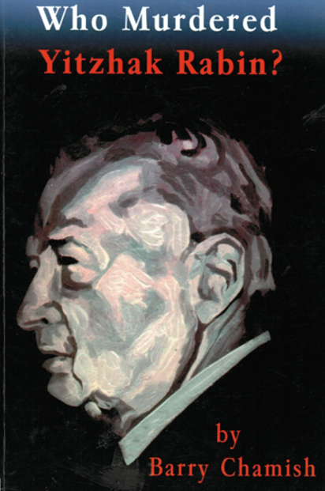
Who Murdered Rabin? (1998)
--Witnesses shouted: “They’re blanks!”
--Rabin walked to the car--with no visible wounds.
--In the O.R. his T-spine was seen as crushed.
--No gunpowder residue was found on Amir’s hands.
--Ballistics tests did not match Amir’s gun.
--Nahum Shahaf (Israeli physicist) had photo proof
they had the wrong man.
--Amir: “If I were to tell the whole truth, the entire system would collapse. I know enough to destroy this country.”
Assassination attempts were made on Barry—so he abandoned Israel for Florida.

Slide 60
Mexico: Colosio
The 1994 slaying of Mexican presidential candidate Luis Donaldo Colosio has become an open sore in the Mexican political psyche. Mexicans have refused to accept this as due to a lone gunman.

Slide 61
JFK was Killed by Consensus
Dealey Plaza, Mantik argues, was merely the final stop in a meticulously orchestrated operation with fingerprints reaching deep into the military-industrial-intelligence complex. From McGeorge Bundy’s real-time narrative control to the fictitious third bullet shell, from the concealed movie film shot from the north pergola to the fabricated Oswald timeline, the cover-up was as coordinated as the crime.
Mantik’s fearless synthesis pulls no punches and dares to name names, offering readers a devastating account of how truth was not only buried—but replaced.

Slide 62
JFK was Killed by Consensus
This book is mainly about relationships—among the sponsors.

Slide 63
Can someone be guilty under RICO (1970) -- solely due to their relationships?
Yes! Someone can be found
guilty under RICO solely due to relationships.
RICO charges can be built around indirect involvement.
These often rely on a broad conspiracy theory that includes people who
never personally committed a violent crime, e.g., an assassination.

Slide 64
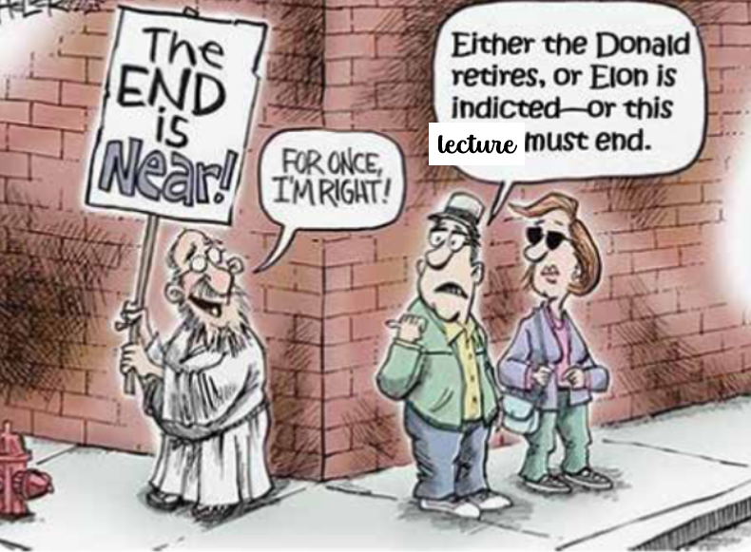
lecture

Slide 65
